Slide 1
SUMMATIVE ASSESSMENT
INTRODUCTION TO PROGRAMMING
Beenish Idrees | CC4

Slide 2

Exercise 1: Coding is cool

Slide 3

Exercise 2: Simple sums

Slide 4
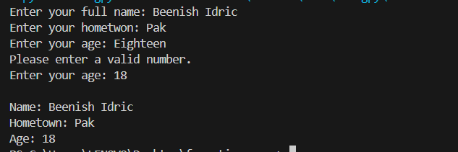
Exercise 3: Biography

Slide 5
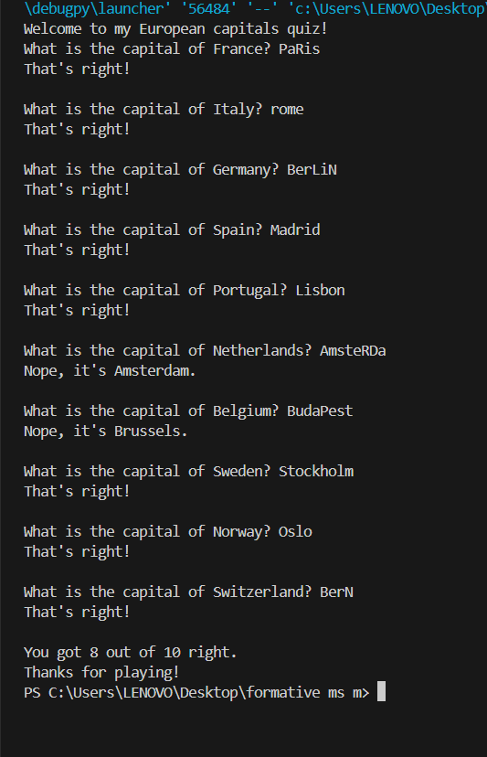
Exercise 4: Primitive Quiz

Slide 6
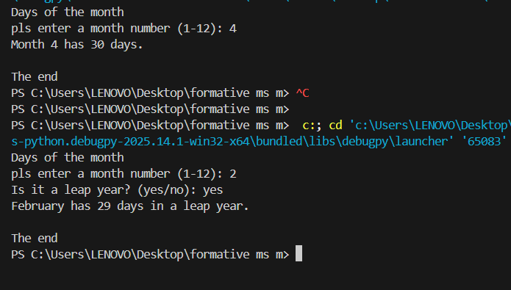
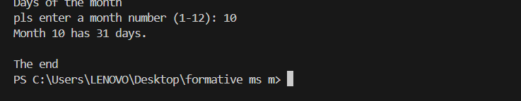
Exercise 5: Days of the month

Slide 7
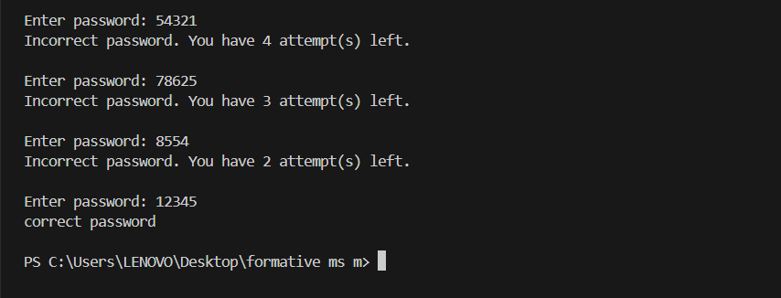
Exercise 6: Brute force attack

Slide 8
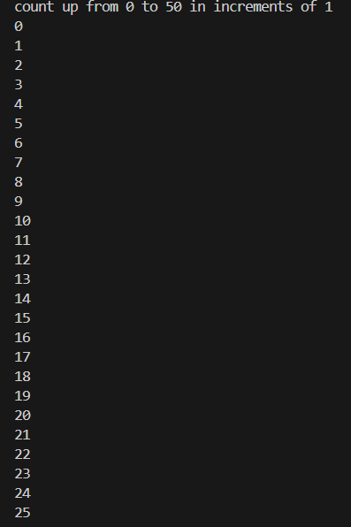
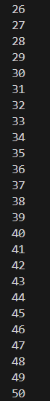
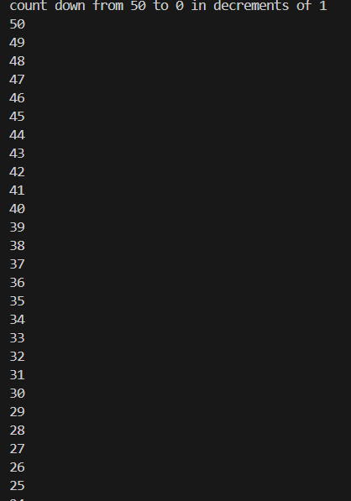

Exercise 7: Some counting

Slide 9
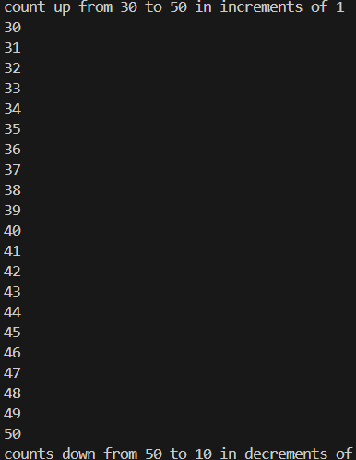
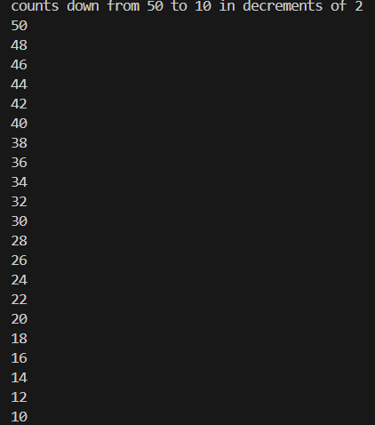
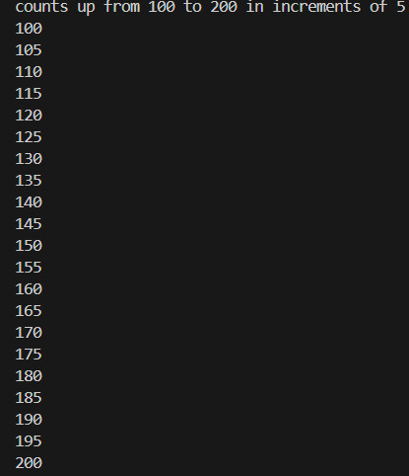
Exercise 7: continue..

Slide 10
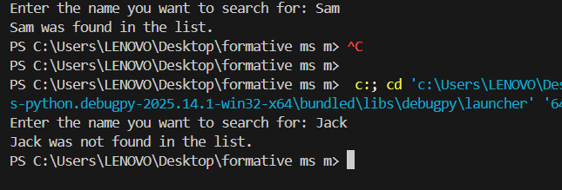
Exercise 8: Simple search

Slide 11
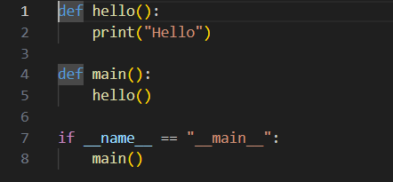
Exercise 9: Hello

Slide 12


Exercise 10: Is it even?

